Slide 1
DISCUSSION ANSWERS
Cloud Computing & Ethics
Genomic mutations in tuberculosis and antibiotic resistance.

Slide 2

CLOUD COMPUTING Q1
Define cloud computing.
Answer: Delivering resources over the internet without owning physical hardware.
On-demand: Instantly launch compute and storage as needed.
Scalability: Handles massive increases in genomic datasets.
Elasticity: Resources expand for peak training and shrink after.
Pooling: Securely share hardware while isolating data.
Pay-as-you-go: Cost-efficient for intensive analysis cycles.

Slide 3
CLOUD COMPUTING Q2
Recommend a service model.
PaaS
Why?
Services
The best choice for managed model training and genomic workflows.
Ready-made analysis platform.
Azure ML (computational biology).
Focus on genomics, not servers.
Google Colab (rapid exploration).

Slide 4

CLOUD COMPUTING Q3
Which deployment model fits your data?
Hybrid Deployment Model
Balances privacy, cost, and flexibility.
Data Separation:
Public Cloud: Cost-effective analysis of non-sensitive public genomes.
Private Cloud: Secure isolation for sensitive patient clinical metadata.

Slide 5
CLOUD COMPUTING Q4
Sketch the cloud pipeline.
1
2
3
4
Storage
Preprocessing
Training
Delivery
Public repositories & secure hospital samples.
Sequence cleaning & variant annotation.
Train models to identify resistance markers.
Clinical insights via end-user dashboards.

Slide 6


Ethics Answers
Addressing the ethical questions raised by genomic data.

Slide 7
ETHICS Q1
Ethical issues and how to address them?
Privacy & Confidentiality
Informed Consent
De-identification, encryption, and strict access controls.
Transparent policies for patient-linked clinical records.
Dataset Bias
Potential Misuse
Validate across diverse populations to prevent skew.
Strictly limit interpretations to scientific public health.

Slide 8


ETHICS Q2
Obligations under Kenya DPA 2019?
Handling Kenyan patient data requires strict adherence.
Obtain clear informed consent for sensitive health data.
Apply strong security controls and data encryption.
Ensure lawful transfer and strict retention limits.

Slide 9


ETHICS Q3
Identify one risk and one safeguard.
The Risk
The Safeguard
Incorrect mutation classification, leading to toxic, expensive, or ineffective medical treatments.
Validate with independent datasets and use purely as a human-reviewed decision-support tool.

Slide 10
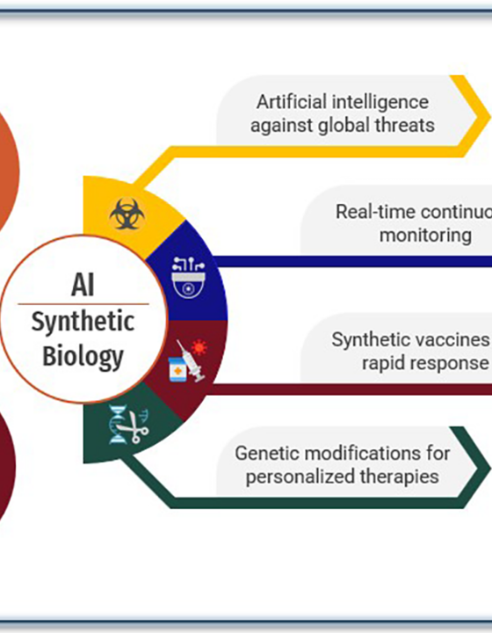
PRACTICE QUESTION
Ziwa Biotech ethical issues?
Ecological Risk
Mitigated by contained trials & independent ecological reviews.
Community Consent
Handled via transparent communication & local participation.
Governance
Enforced through independent oversight and clear legal frameworks.
Community Consent
Addressed by transparent consultation.
Governance
Addressed by independent oversight.

Slide 11
Project Team
144861 Kiome Ian Mutuma
103023 Mbai Njeke Silver
169275 Louis Muiyuro Karanja
134976 Kipngetich Emmanuel Keter
158716 Mwangi Mary Queenvine Muthoni
167612 James Trevor
146414 Wesly Ryan Mugele

Slide 12




Image Sources
https://img.magnific.com/premium-vector/abstract-glowing-dna-double-helix-structure-with-futuristic-digital-network-node-background_41981-4357.jpg?semt=ais_hybrid&w=740&q=80
Source: www.magnific.com
https://media.istockphoto.com/id/2237822747/photo/futuristic-data-center-with-high-speed-digital-transmission-lines-ai-analytics-and-big-data.jpg?s=612x612&w=0&k=20&c=R6Ka6gLzES8_Patu00biEb9sAFTO7qzKCbXsWHl3XWQ=
Source: www.istockphoto.com
https://usercentrics.com/wp-content/uploads/2023/07/uc_blog_1000x1000_fadp_a.jpg
Source: usercentrics.com
https://www.frontiersin.org/files/Articles/1622123/xml-images/fdgth-07-1622123-g001.webp
Source: www.frontiersin.org

